Slide 1
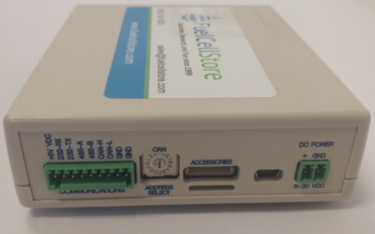
Team 36:
Fuel Cell Monitor
Update Presentation 02/07
Nolan Kao
Mingoo Jung
John Henderson

Slide 2
Project Overview
The Fuel Cell Monitor (FCM) will be able to monitor up to sixteen cell voltages simultaneously and display them on a web interface and a mobile application.

Slide 3
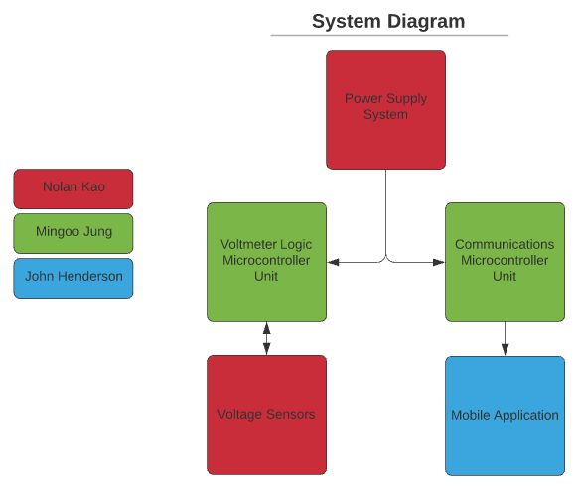
FCM System Diagram

Slide 4
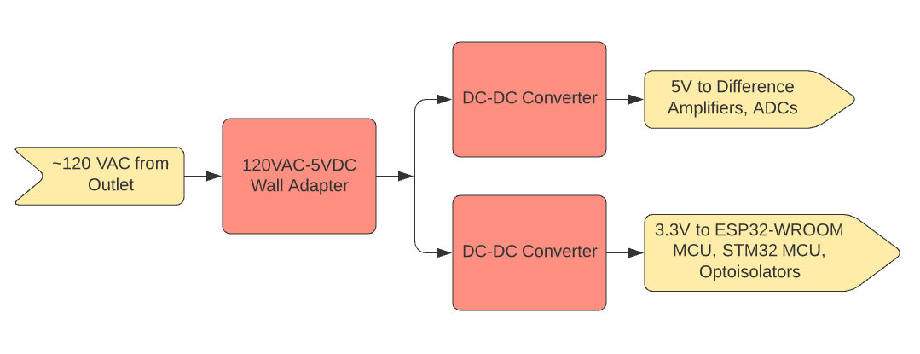
Power Supply Subsystem Diagram

Slide 5
Power Supply Characteristics
120VAC to 5VDC wall plug supplies power to PCB power supply
PCB power supply has two different output source voltages: 3.3V and 5V
3.3V goes to optocouplers, MCUs
5V goes to difference amplifiers, ADCs

Slide 6
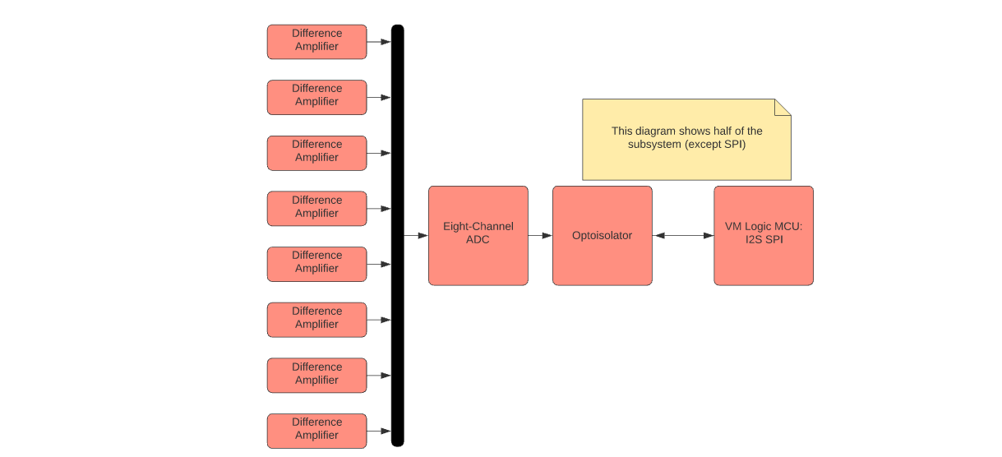
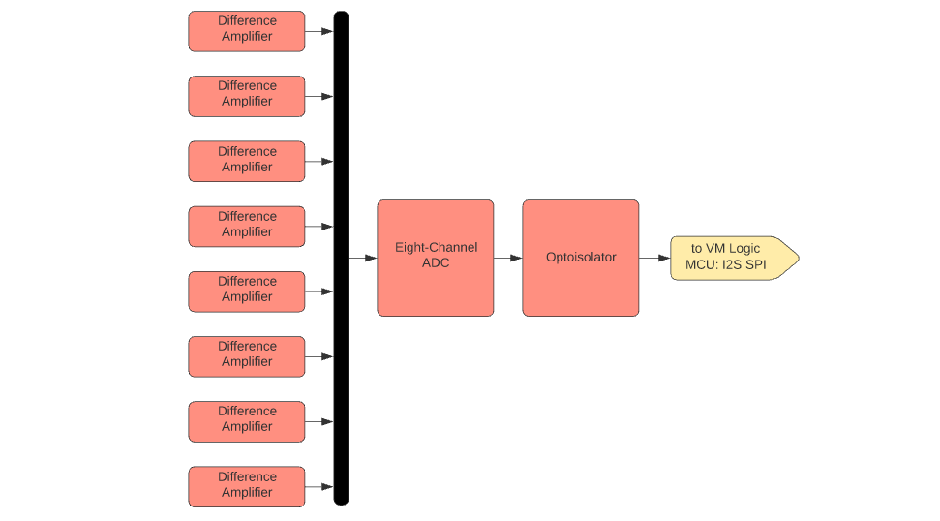
Voltage Sensor Subsystem Diagram

Slide 7
Voltage Sensor Characteristics
Consists of sixteen difference amplifiers, two ADCs, and two optocouplers
Printed on PCB

Slide 8
Update on Power Supply and Voltage Sensors
Nolan Kao
Accomplishments since last week 10 hrs of effort | Ongoing progress/problems and plans until next presentation
Redone redesign of power supply and voltage sensors in Altium. Errors in redesign have been resolved. Finished preliminary design of MCU integration (capacitors/resistors). | Discuss component/peripheral necessities with team. Finalize PCB routing/integration in Altium. Fabricate PCB design through a vendor.

Slide 9
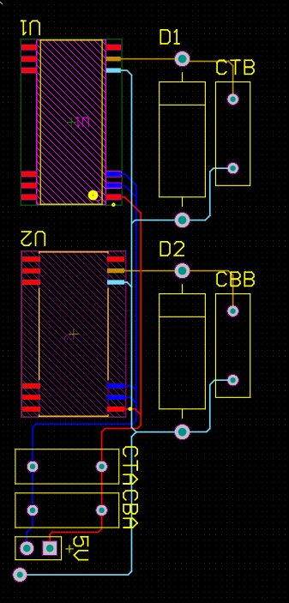
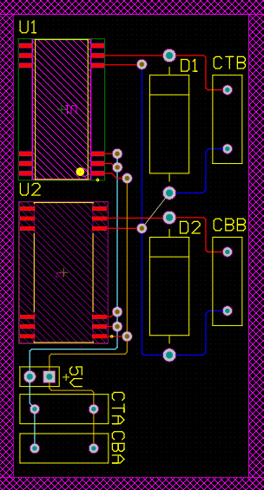
Before
After

Slide 10
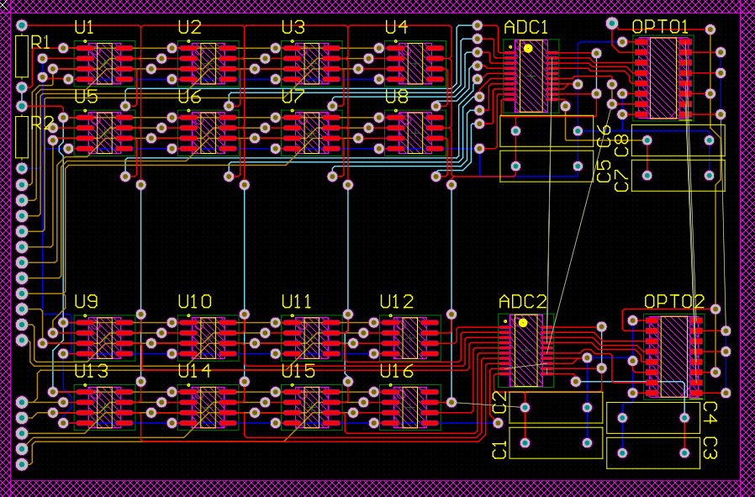
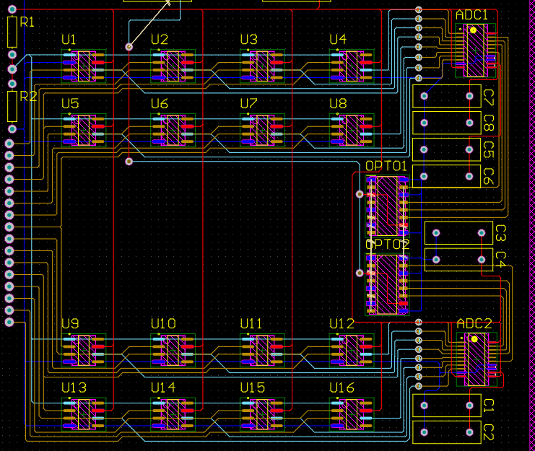
After
Before

Slide 11
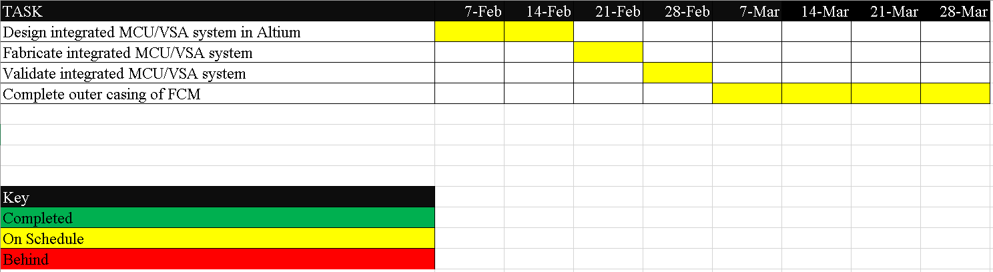
MCU/VSA Schedule

Slide 12
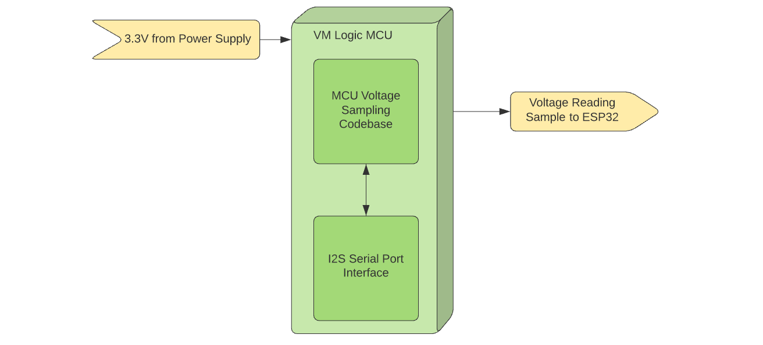
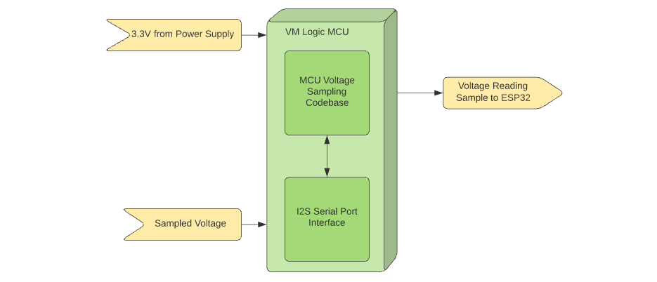
Voltage Logic MCU Subsystem Diagram

Slide 13
Update on MCU Subsystem
Accomplishments since last week 10 hrs of effort | Ongoing progress/problems and plans until next presentation
Validation for external power supplying of MCU subsystem (need to finalize) Redesign PCB for integration of the MCU, power supply and voltage sensor subsystems | Finalize validation for external power supplying of MCU subsystem Start to integration with Smart phone application and the communication MCU data

Slide 14
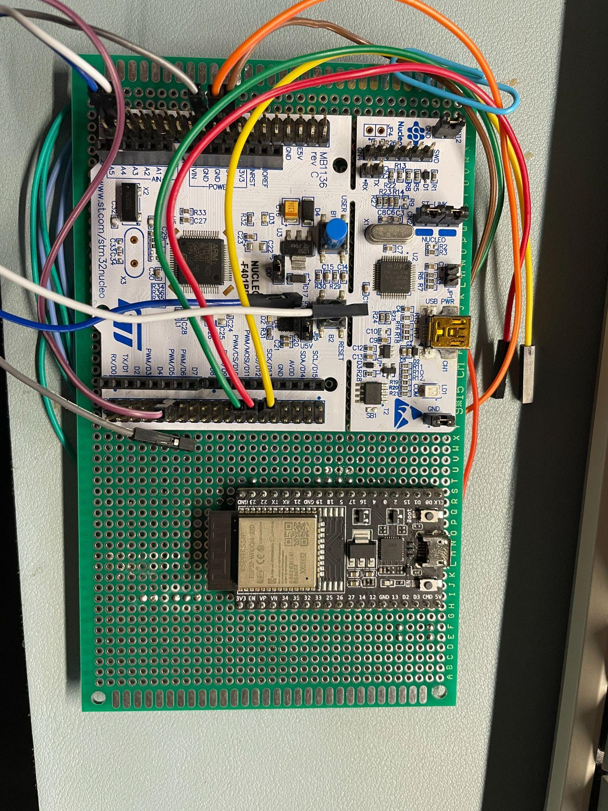
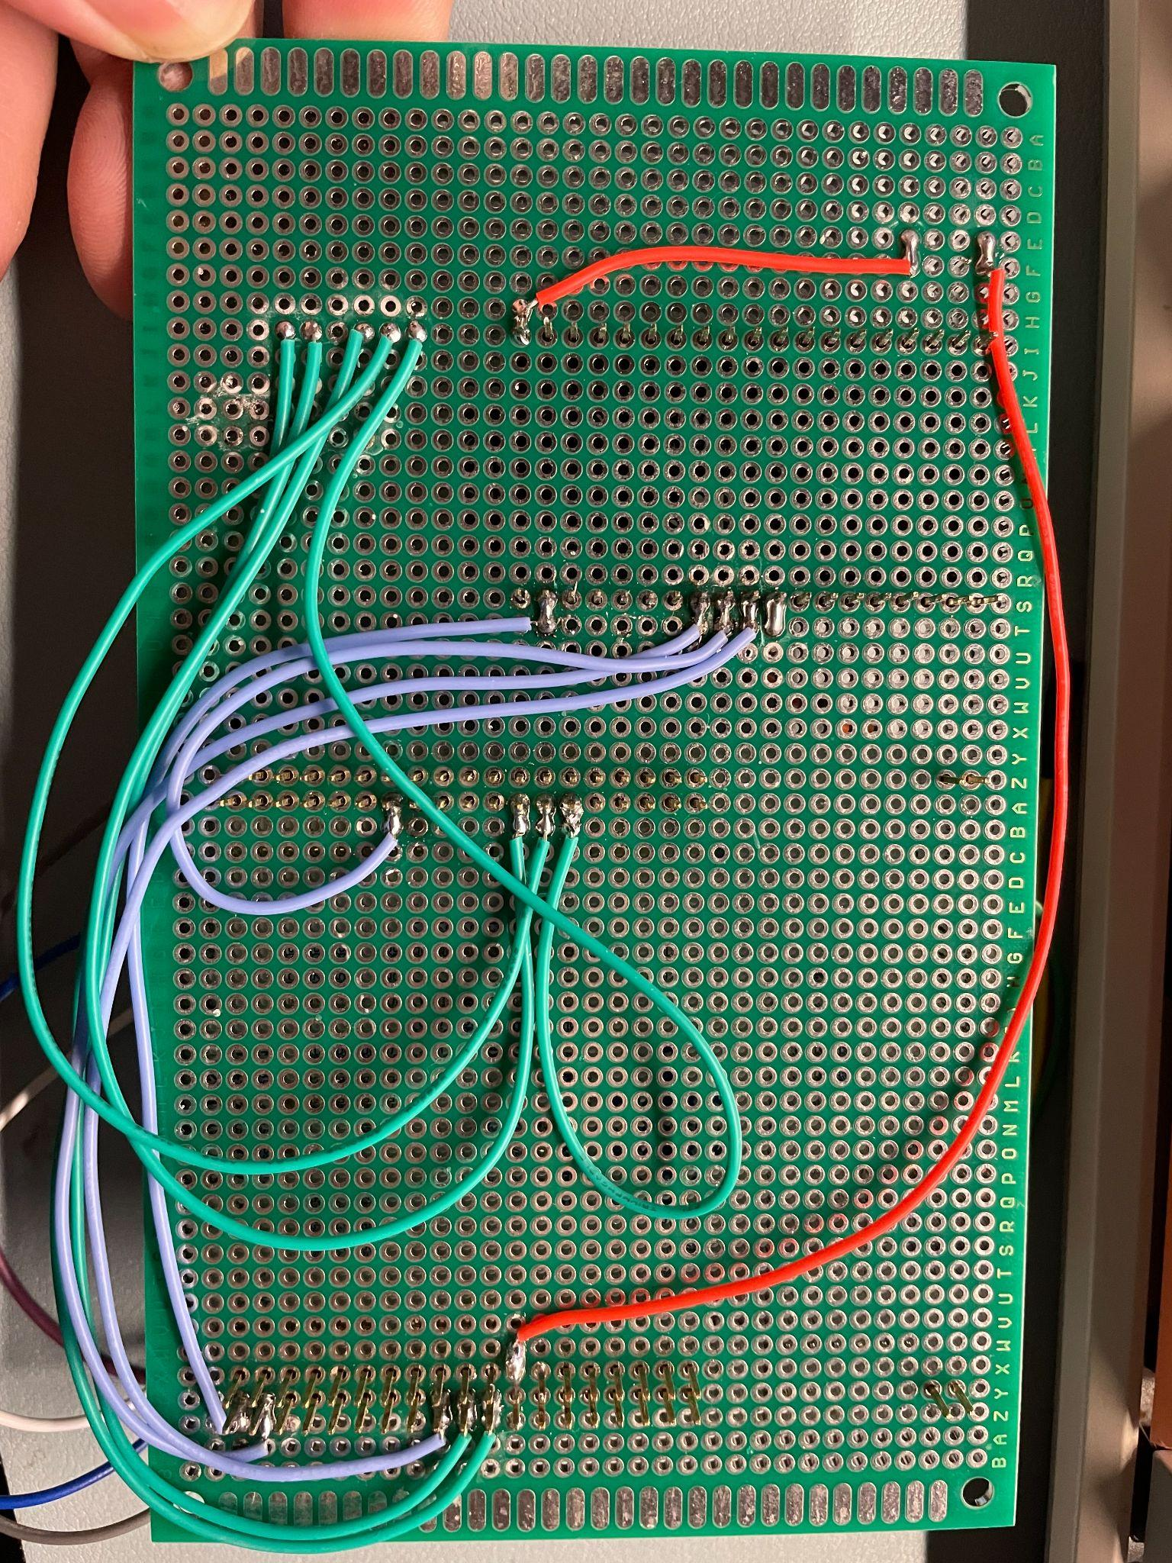
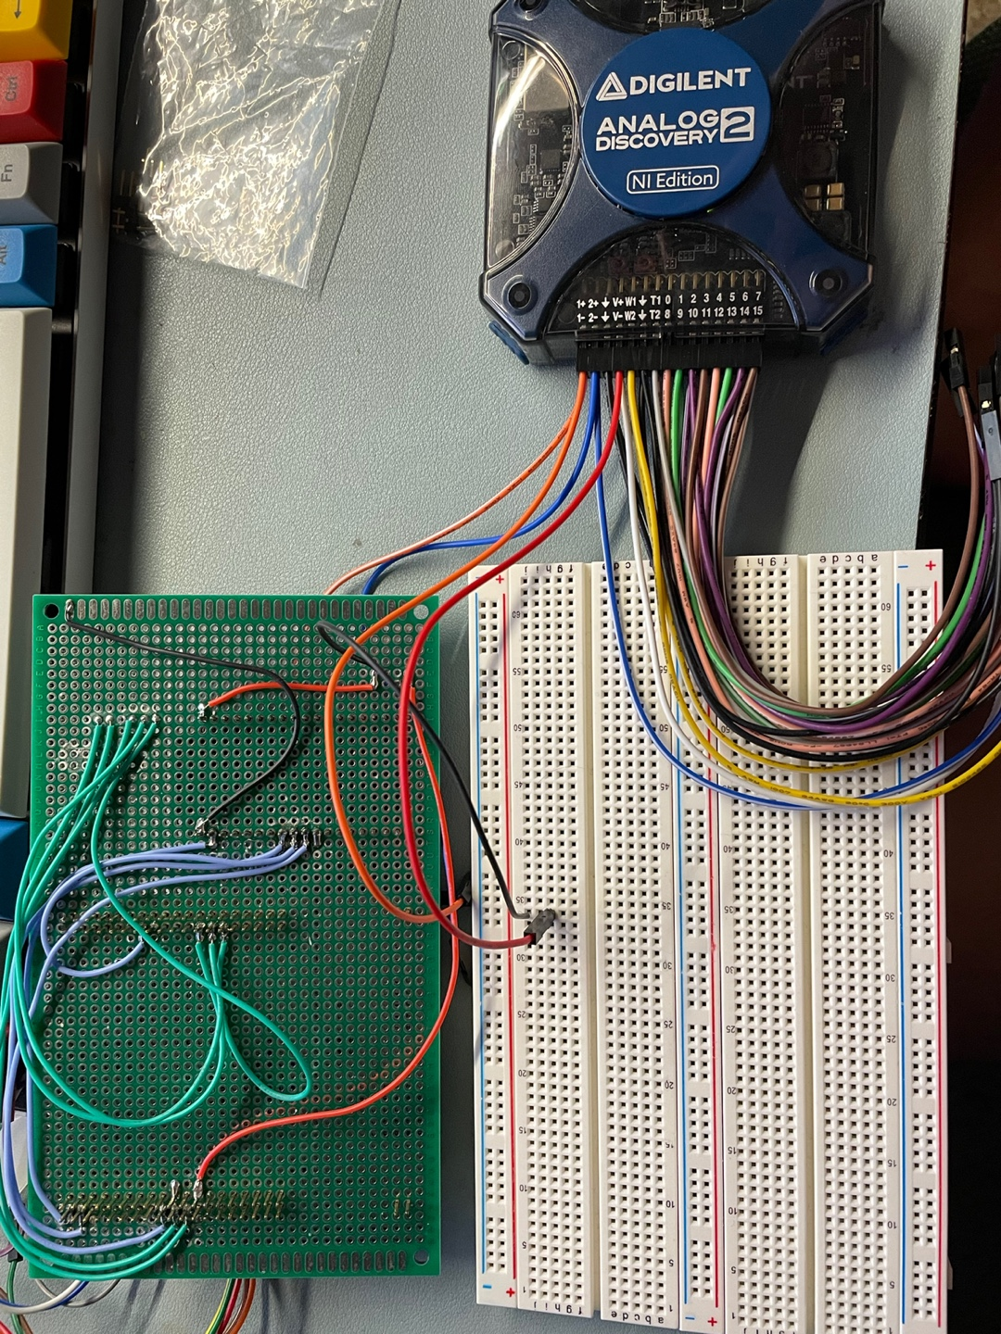
Figure1-1. Actual Wiring between MCUs with soldering
Figure1-2. Actual Wiring between MCUs with soldering
Figure2. Validation for connection between the MCU subsystem and external power supply

Slide 15
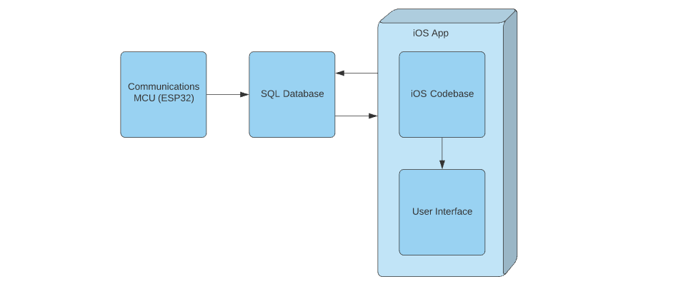
SQL Database and Mobile App Subsystem Diagram

Slide 16
Update on SQL Database and Mobile App
Accomplishments since 403 10 hrs of effort | Ongoing progress/problems and plans until next presentation
Swiping feature completed Mac acquired and project successfully copied over | Integrate bluetooth communication Need to scan for peripherals

Slide 17
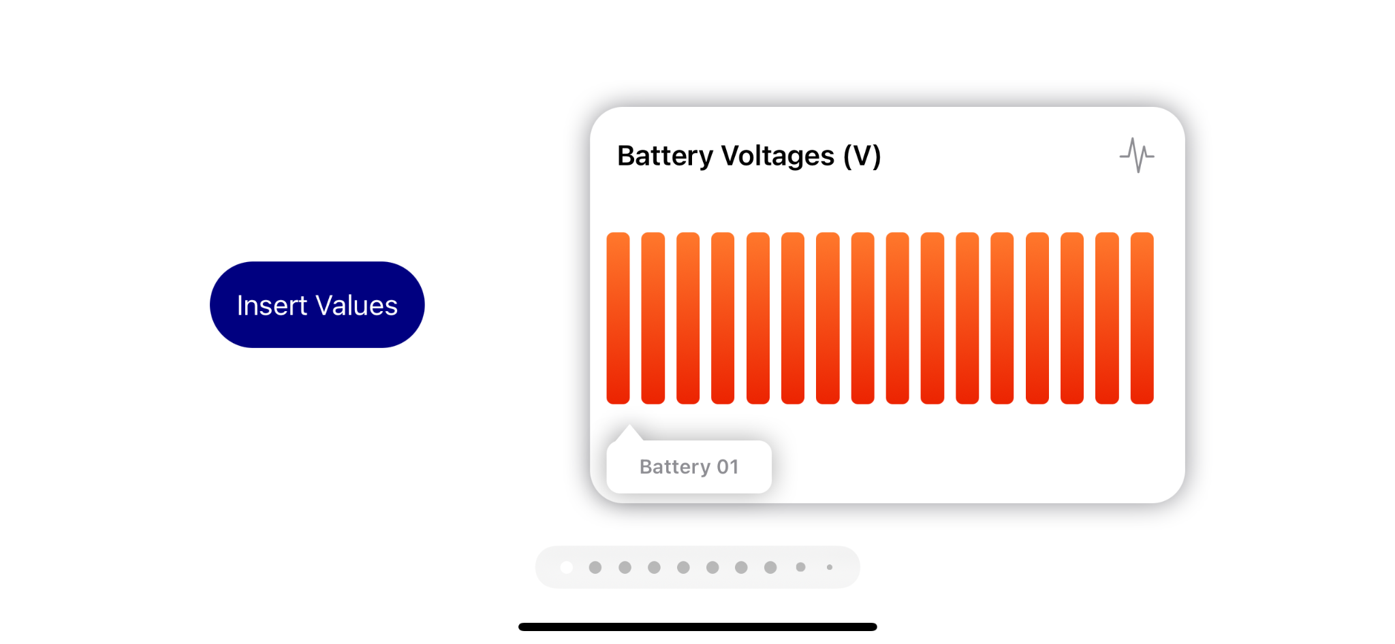
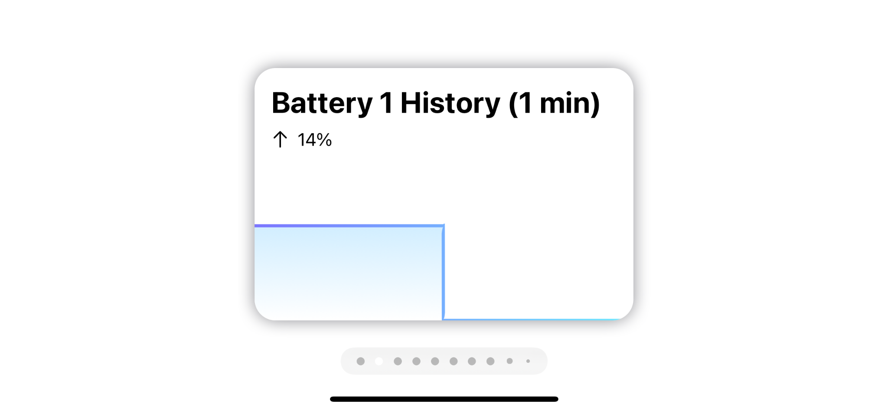

Slide 18
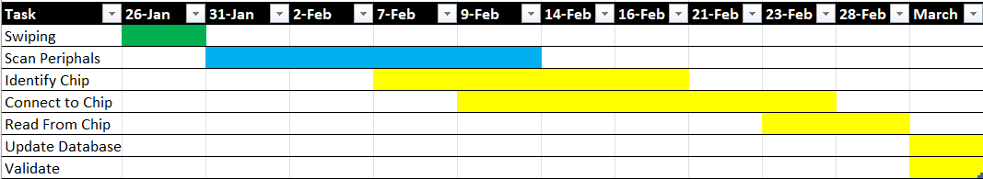
Mobile App Schedule

